Slide 1
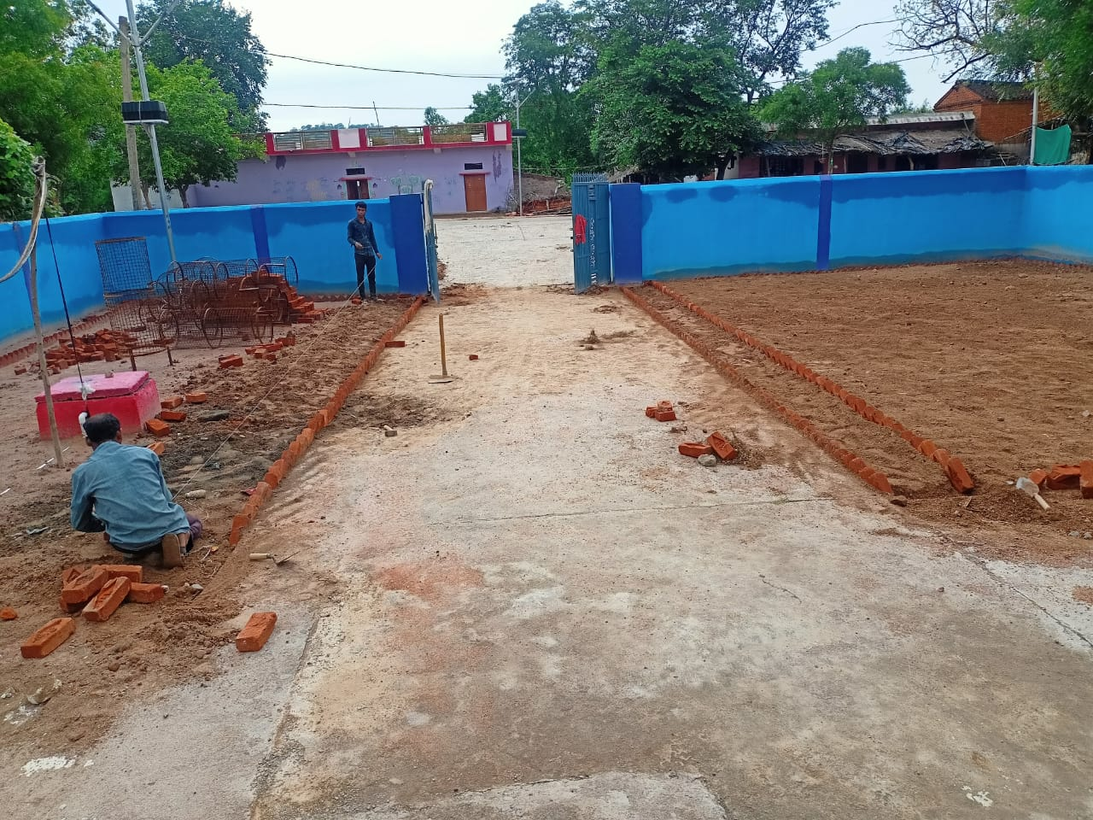
Health : Community Health Centre ( CHC)
Community Health Centre renovation and up gradation with all the modern facilities in Taparian Village.- It is now Smoothly running and continuous support is being provided from our side.
Hygiene.
Patient Footfalls at CHC – 40 / Day

Slide 2
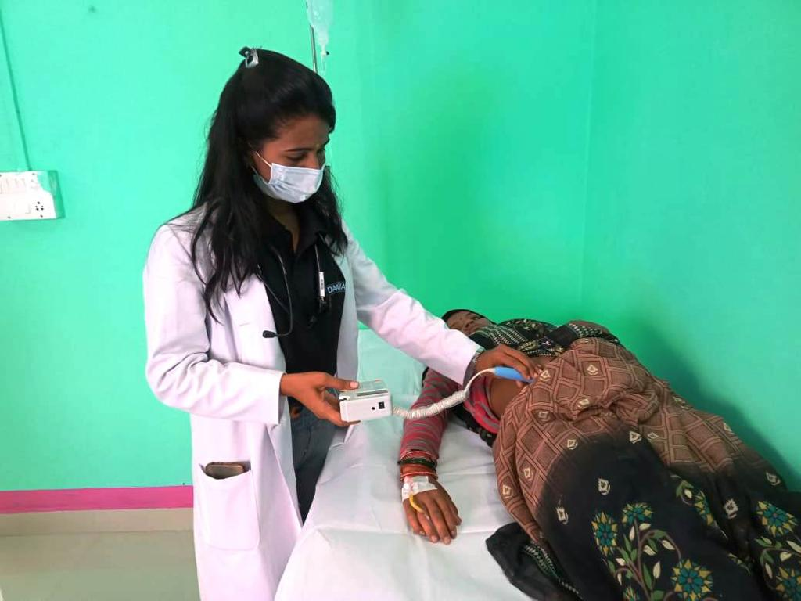
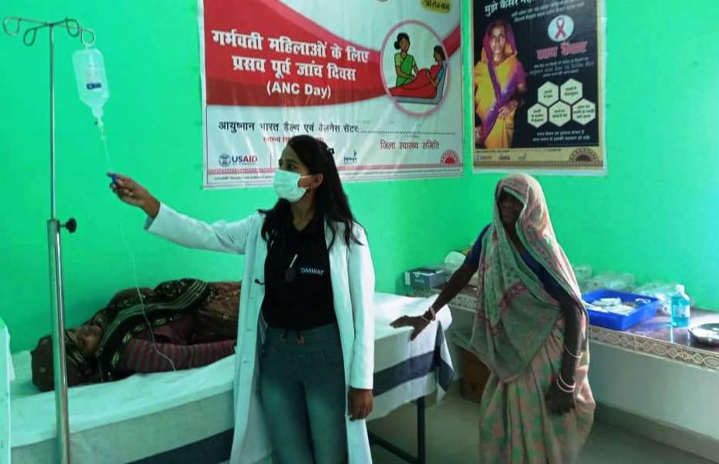
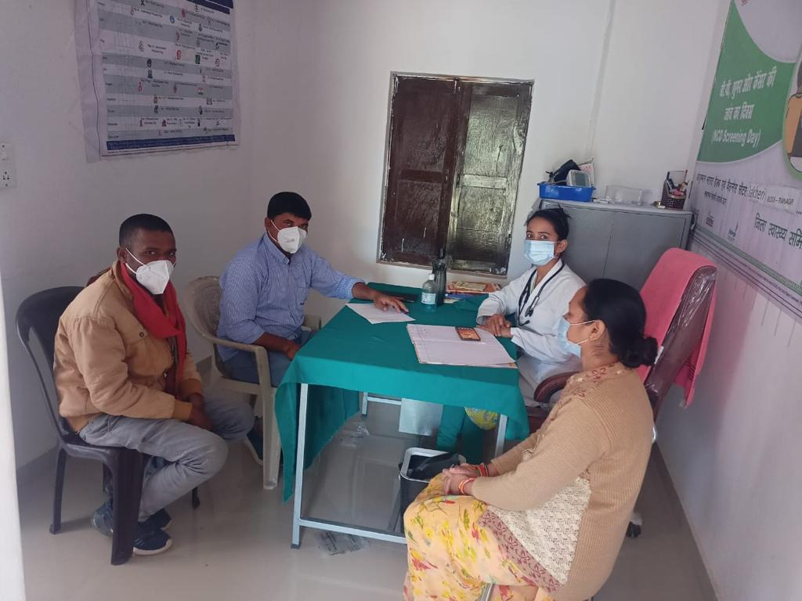
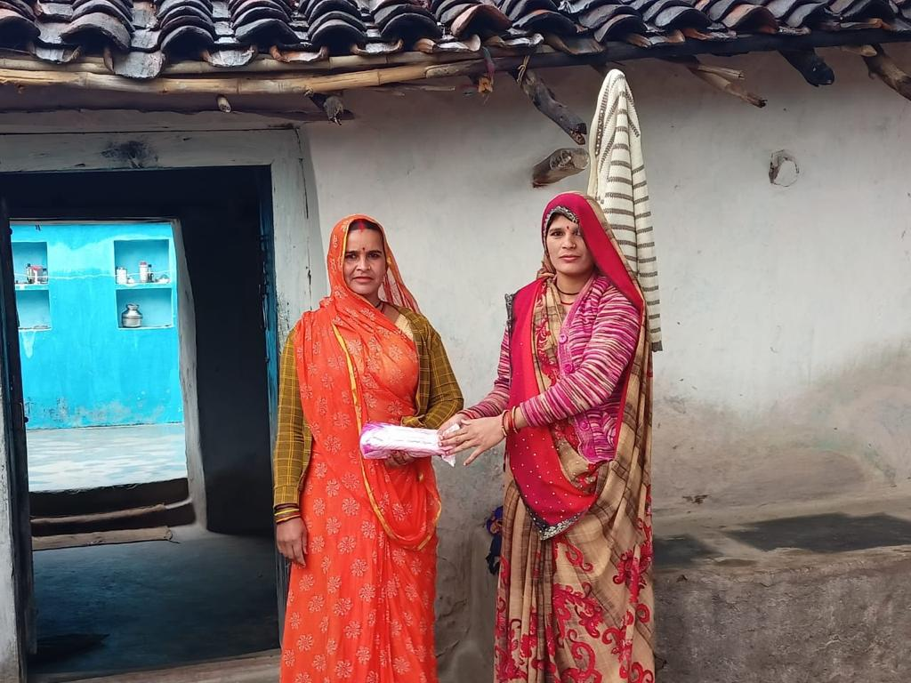
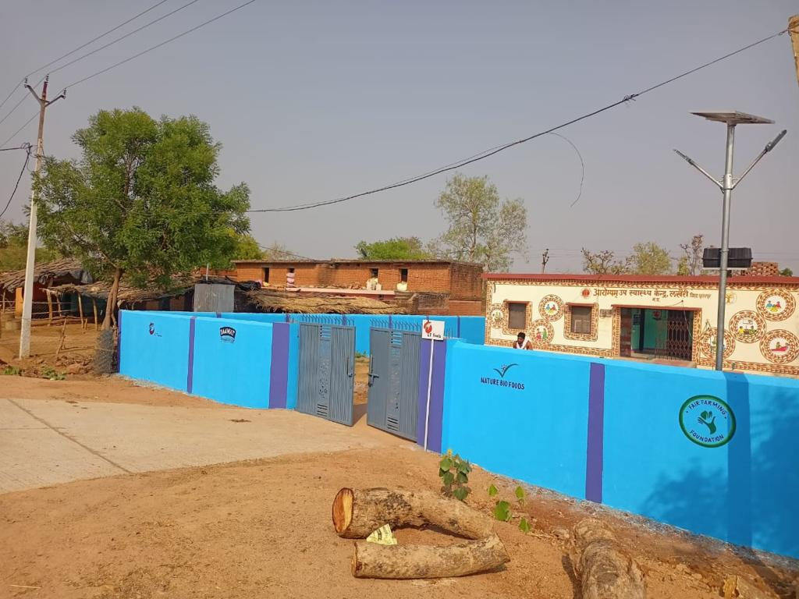
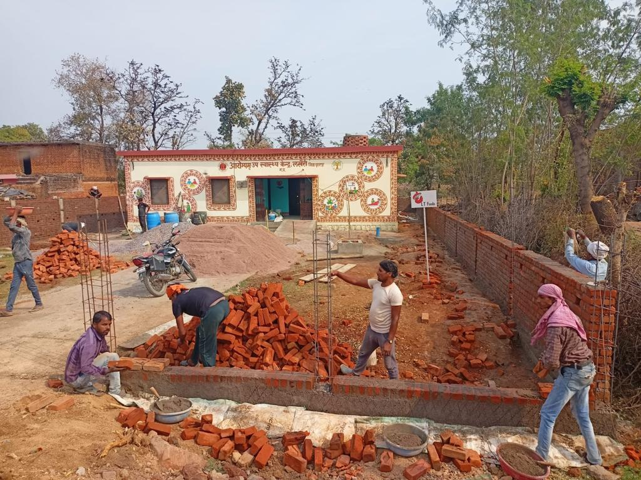

Slide 3
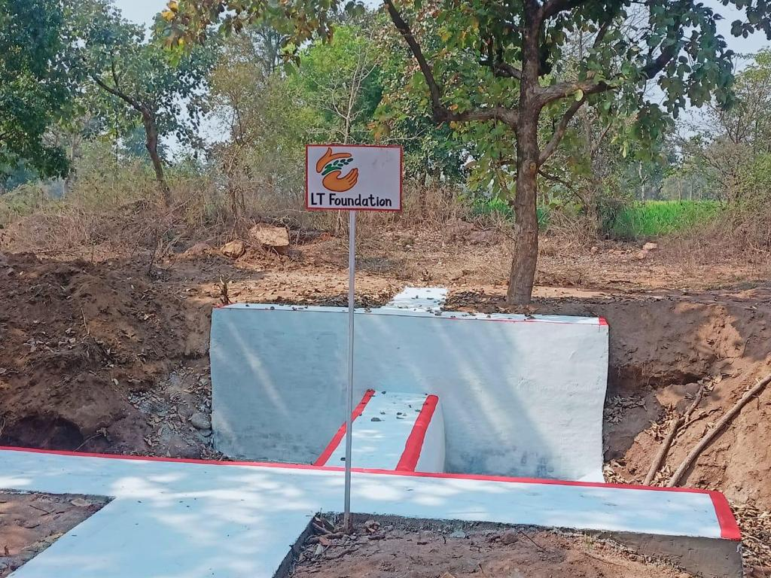
Water Project – Check Dam & Ponds Construction for Water Conservation.
Objective of Check Dam construction was to reduce the wastages of rain waters and other running water sources and to promote water conservation as well. This helps in irrigation the farming land as well.
Construction | New | Old/De-Silting | Water Saved in Lakhs ltrs
Check Dam | 3 | 1 | 52
Ponds | 1 | 1 | 190

Slide 4
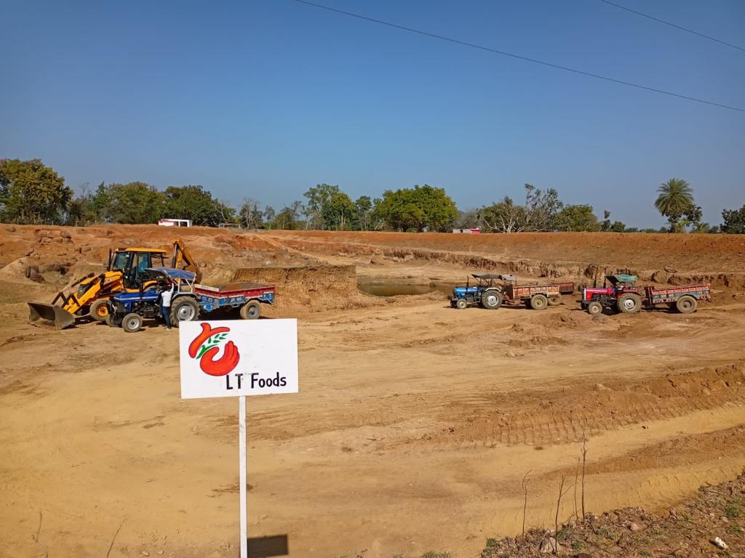
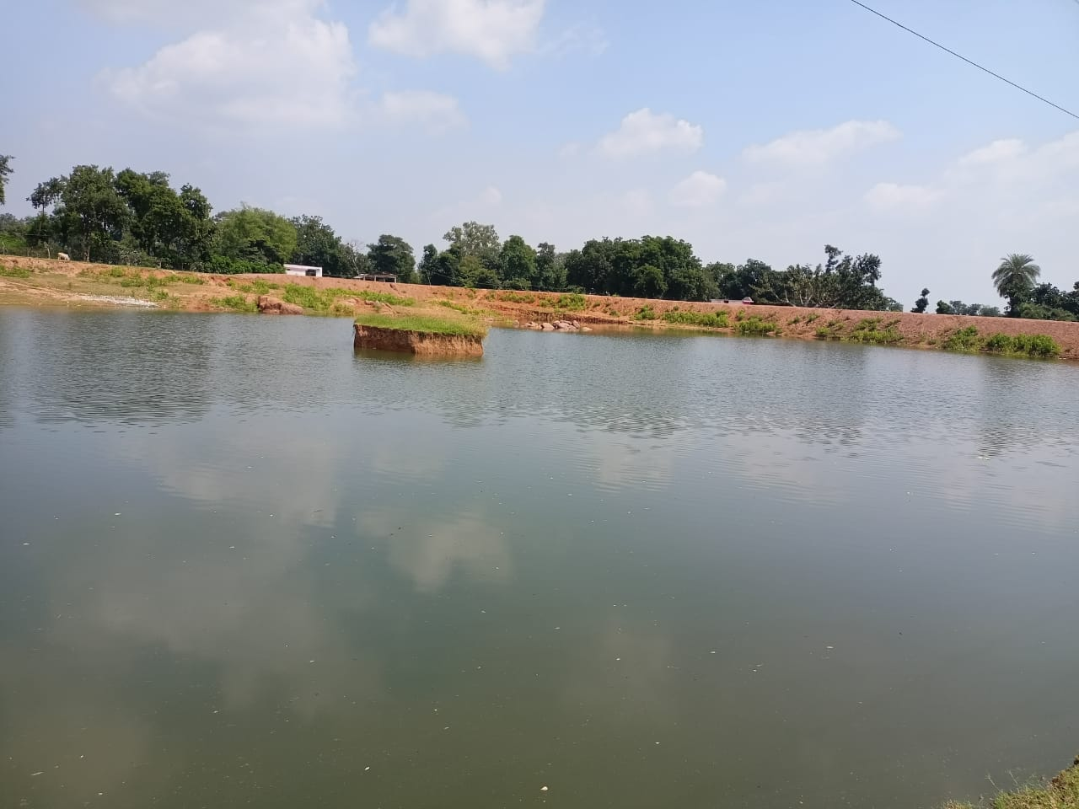

Slide 5
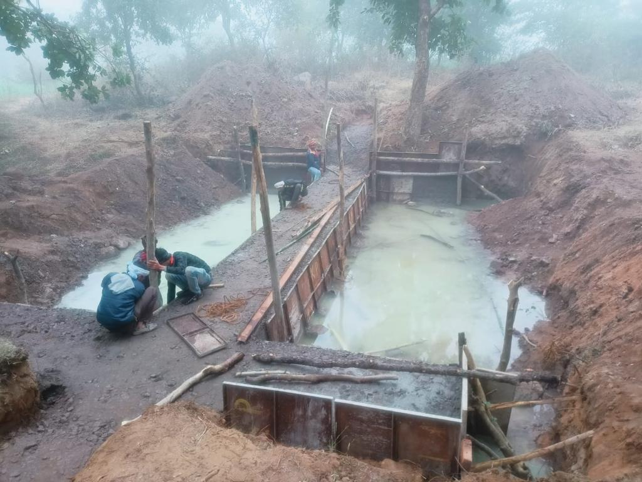
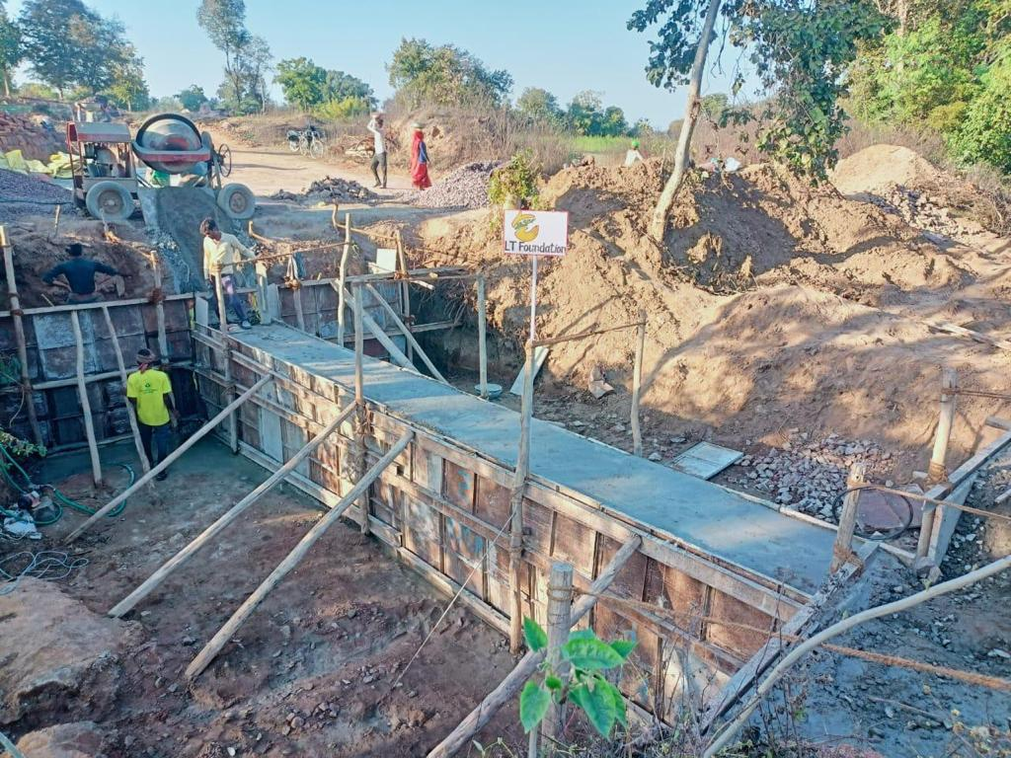
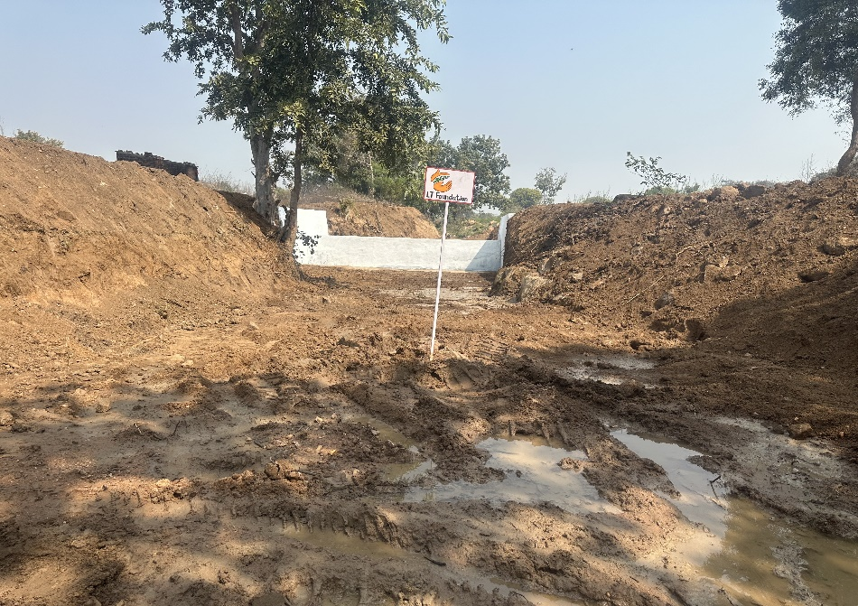
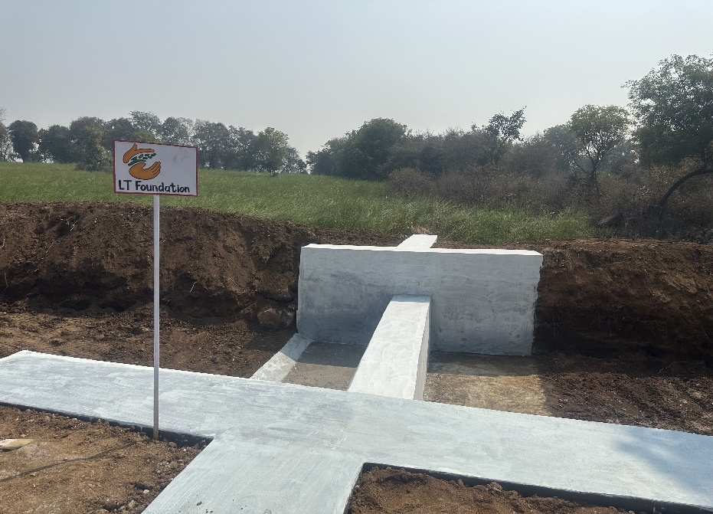
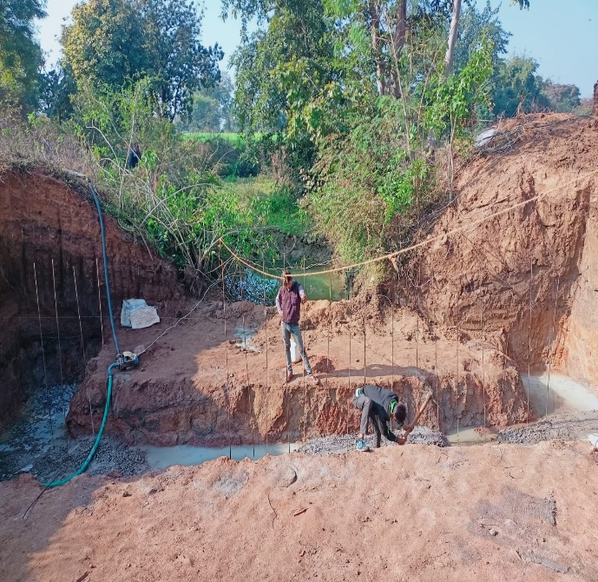

Slide 6
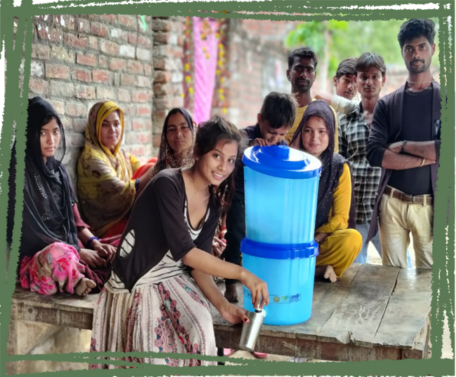
Clean Drinking Water – Community Water Filter & Household Water Filters
Clean Drinking water was a big challenge for the villagers, as the drinking water sources are contaminated with different harmful elements with in the villages. The water from Hand-pumps are also not healthy to drink without filtration. So to provide clean drinking water facilities –
Filter Type | Unit Installed/Distributed | Beneficiary | Capacity
House Hold Water Filter | 700 | 3500 | 15 Ltrs
Community RO Water Filters | 14 | 6600 | 1000 ltrs

Slide 7
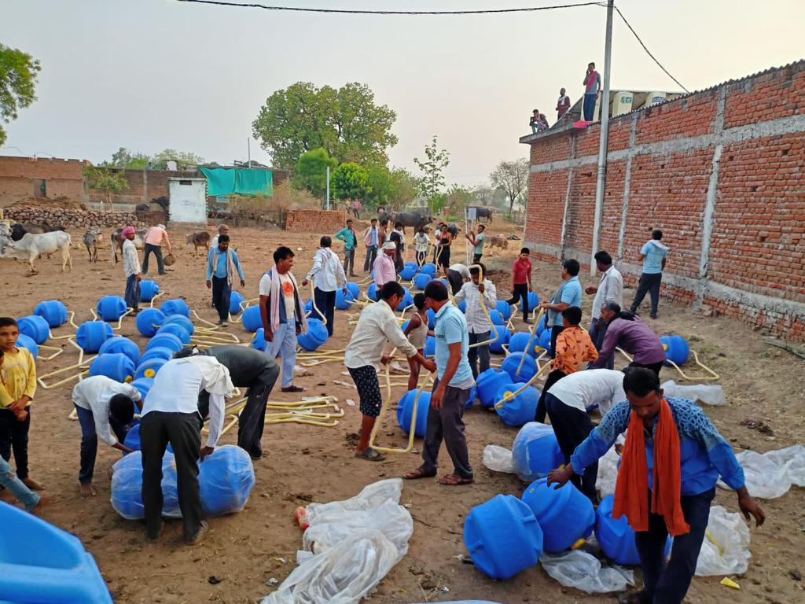
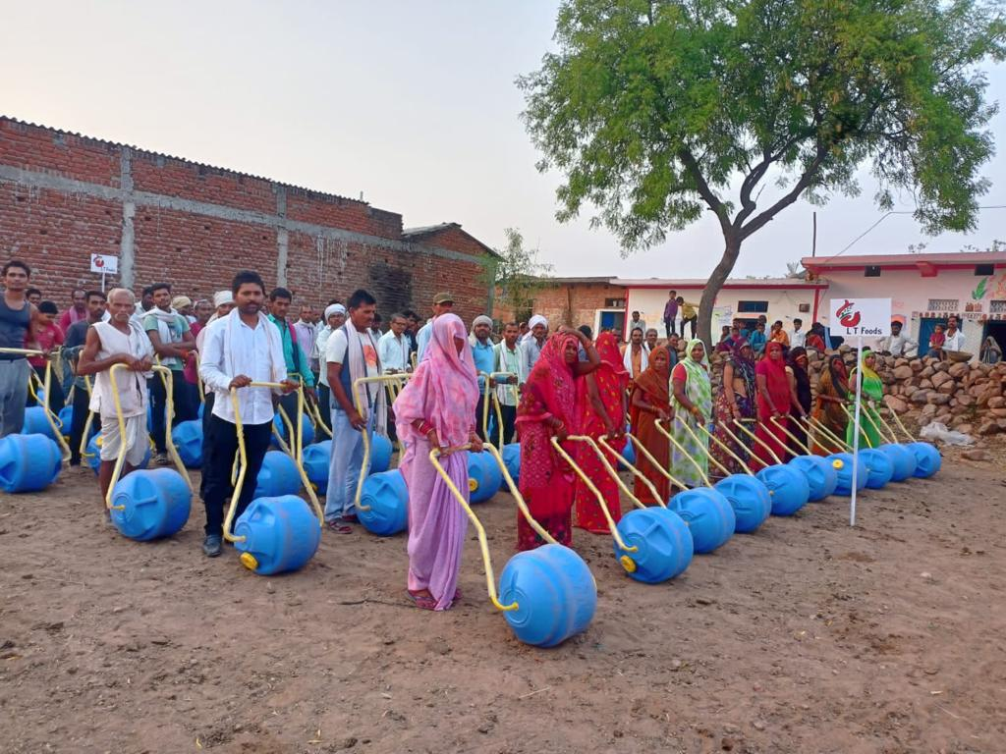
Water Project – Water Wheels
Being a very dry area, the villagers of Chattarpur project location face a great difficulties in carrying water to their homes from the distant water sources during heavy summer. Carrying water on heads or other hands caused great difficulties for the families.
As a solution to this, in 2022-23 we had distributed Water Wheels, which were very easy to use and comfortable for any members of the families to carry water from distances.
Beneficiaries: 200

Slide 8
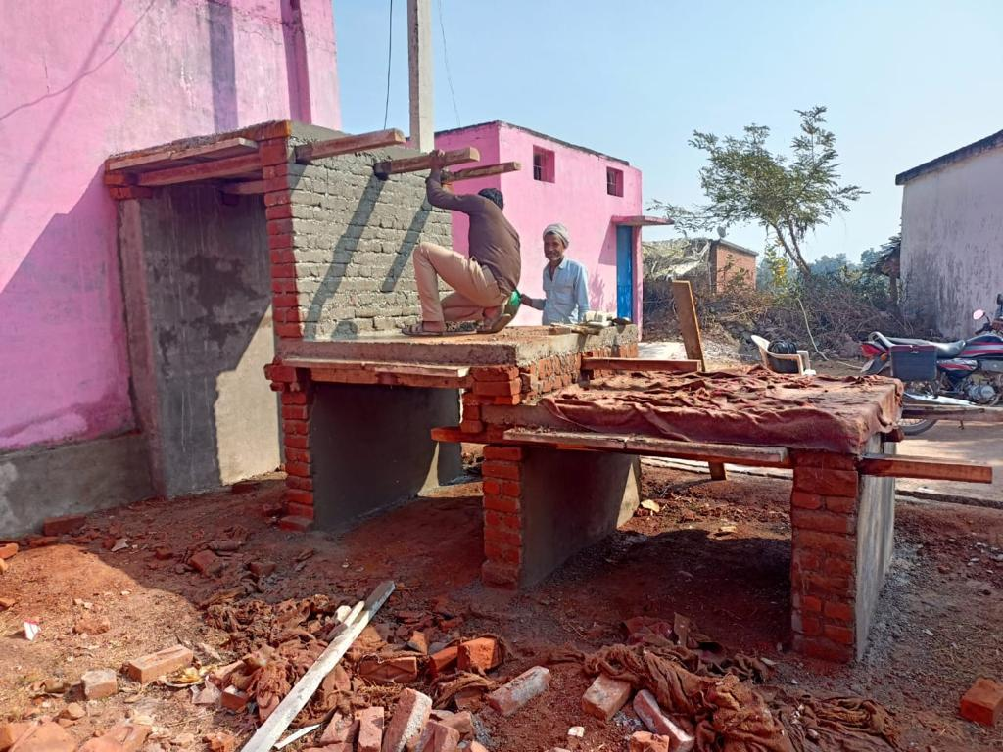
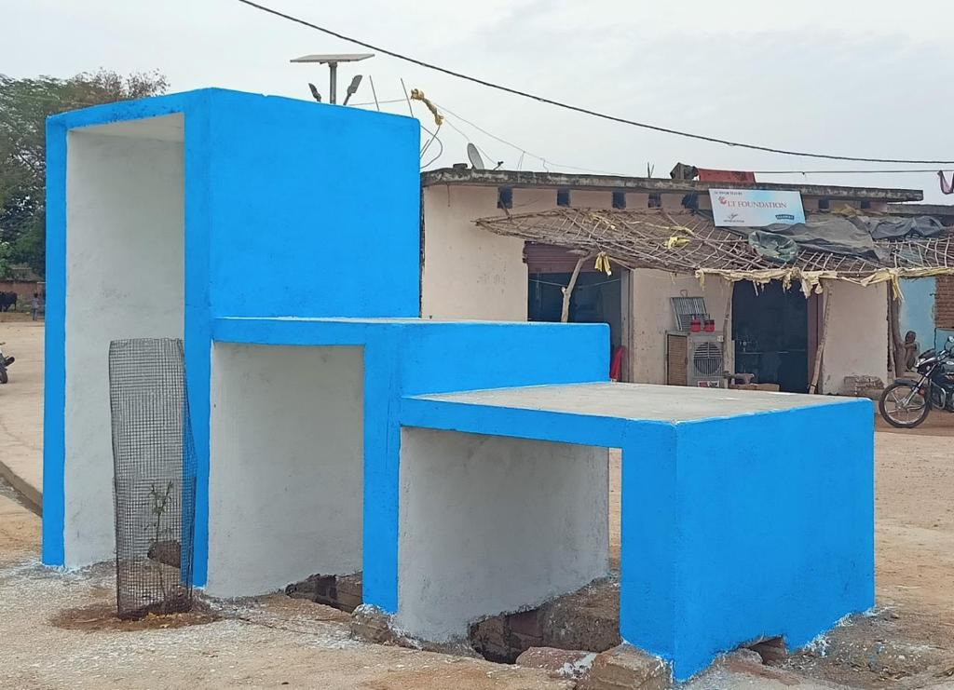
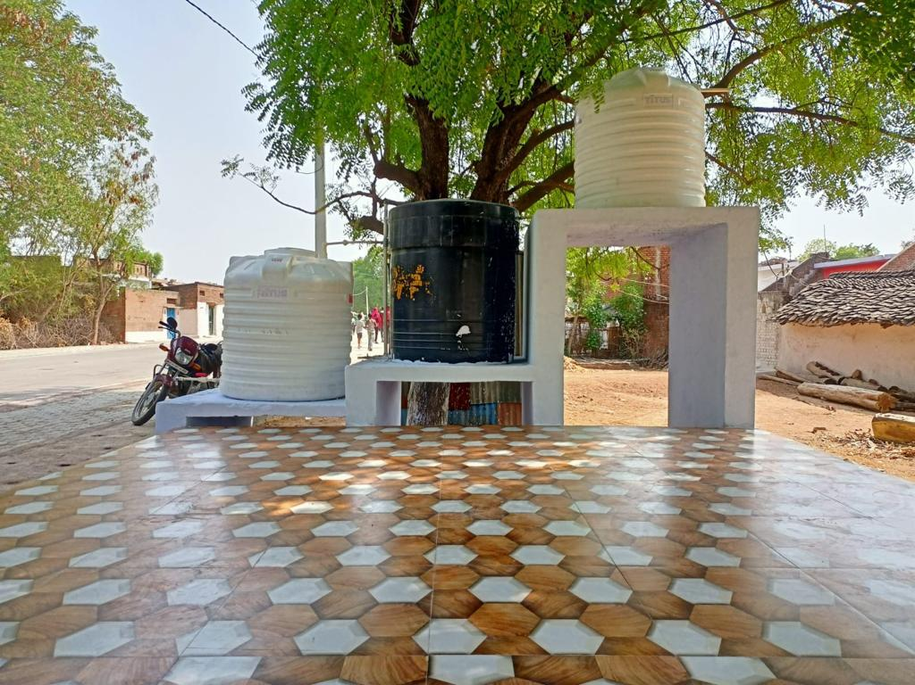
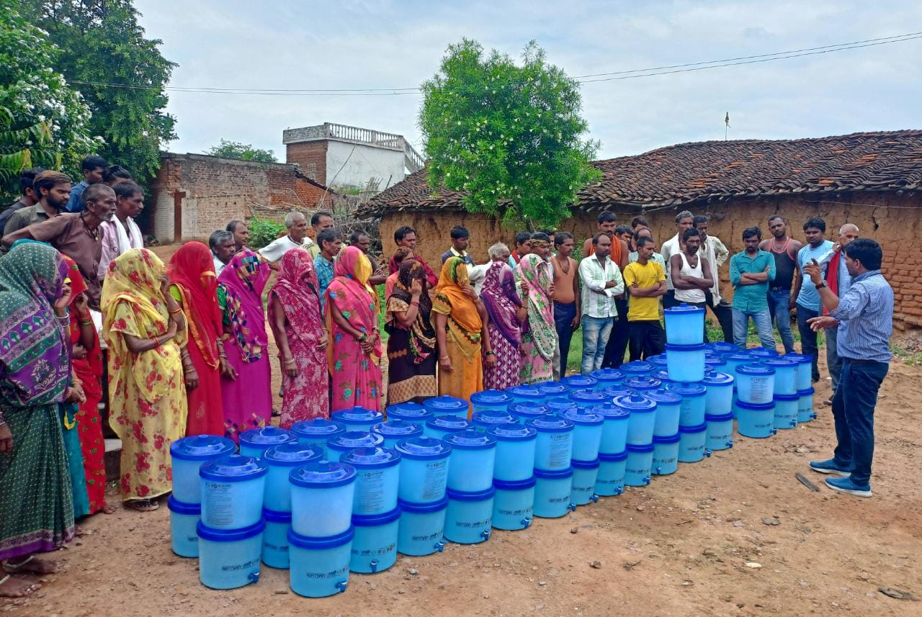
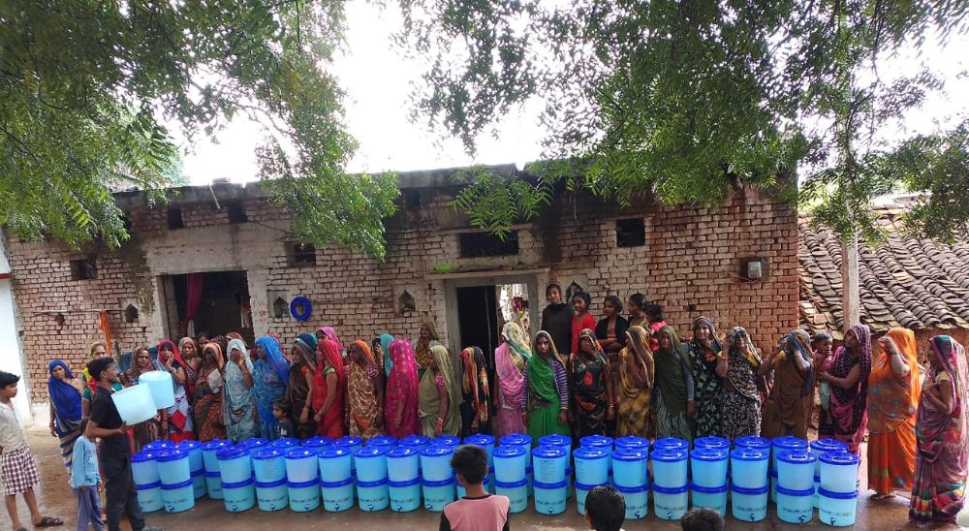

Slide 9
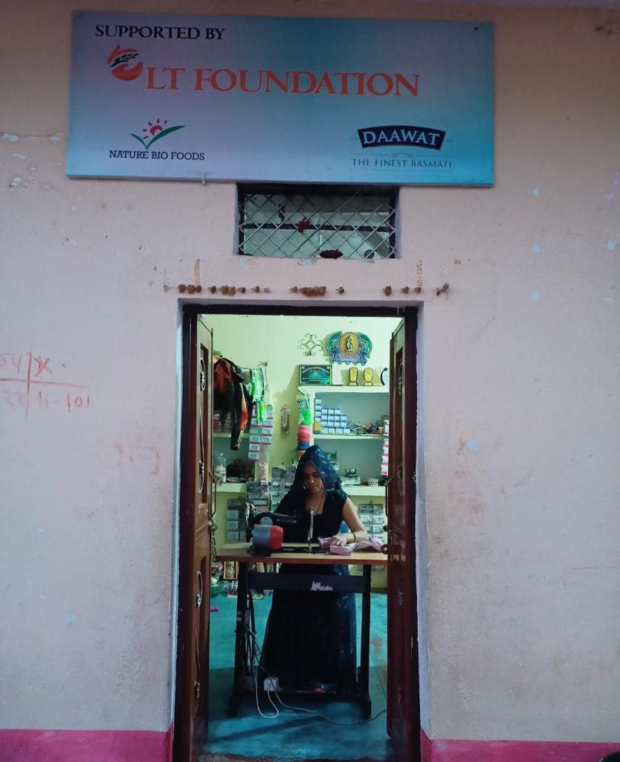
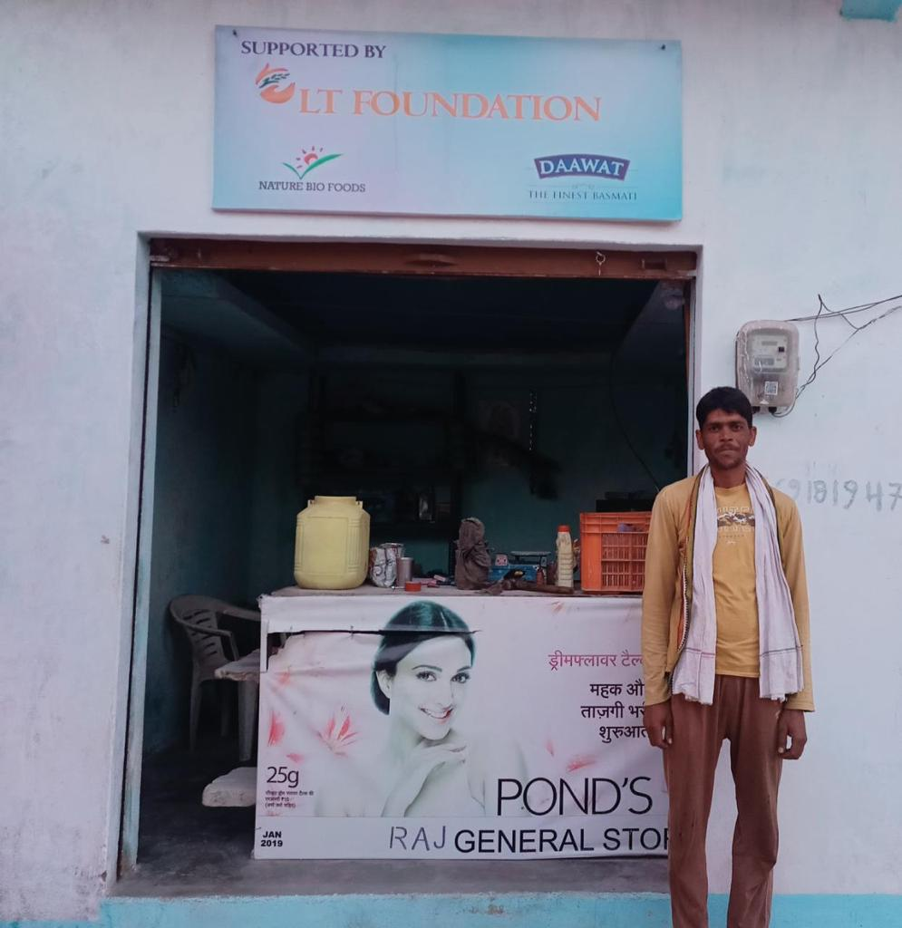
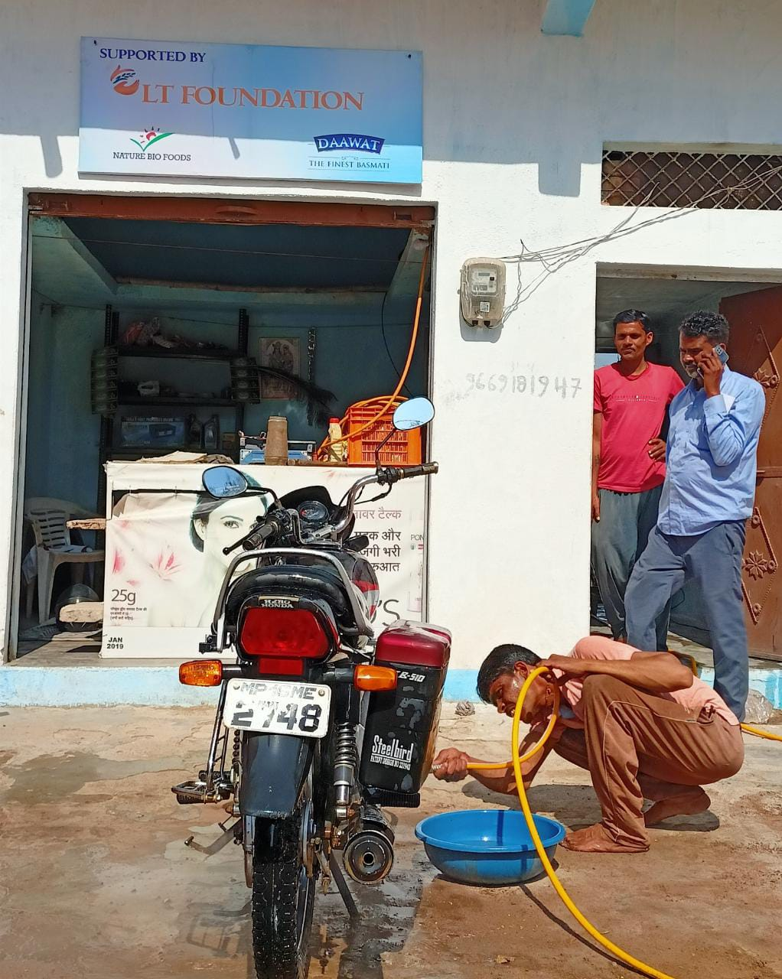
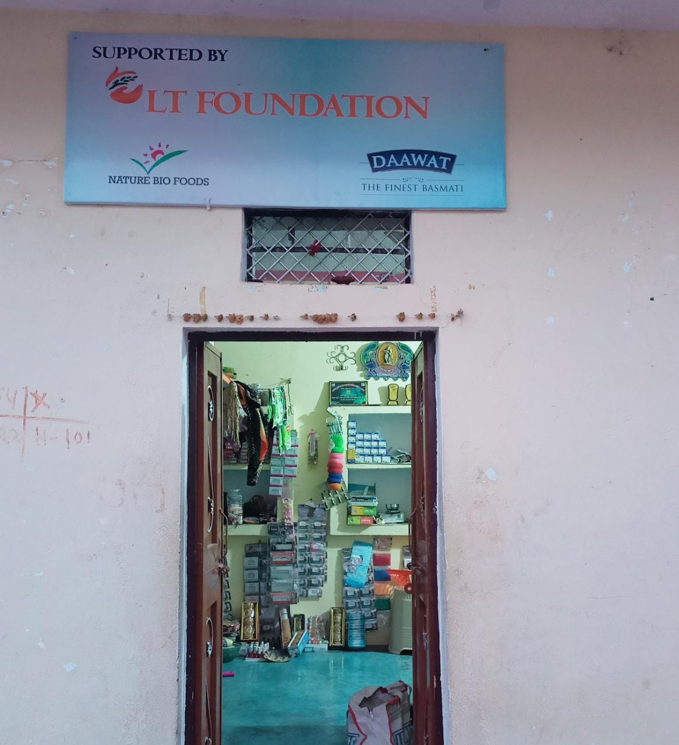
Livelihood Support
To support the villagers in their livelihood different trainings were provided.
Training Provided to Over 100 beneficiaries on various income generation activities
Out of which 8 beneficiaries opened their income generation units supported by LT Foundation

Slide 10
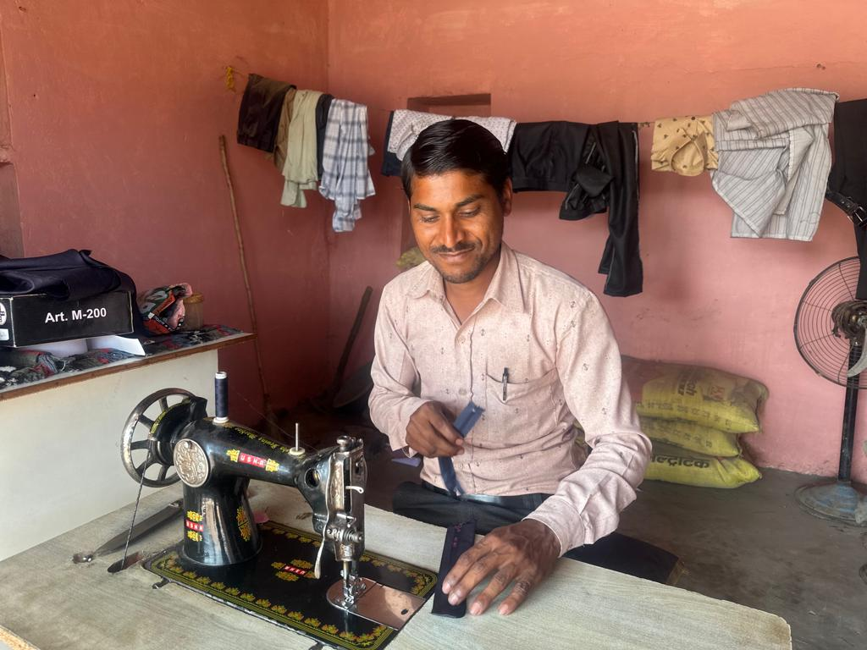
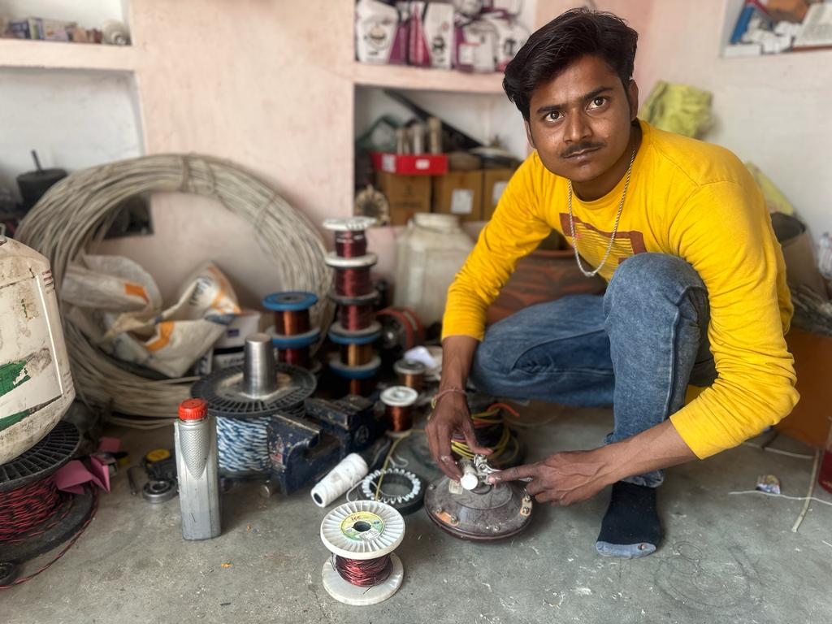
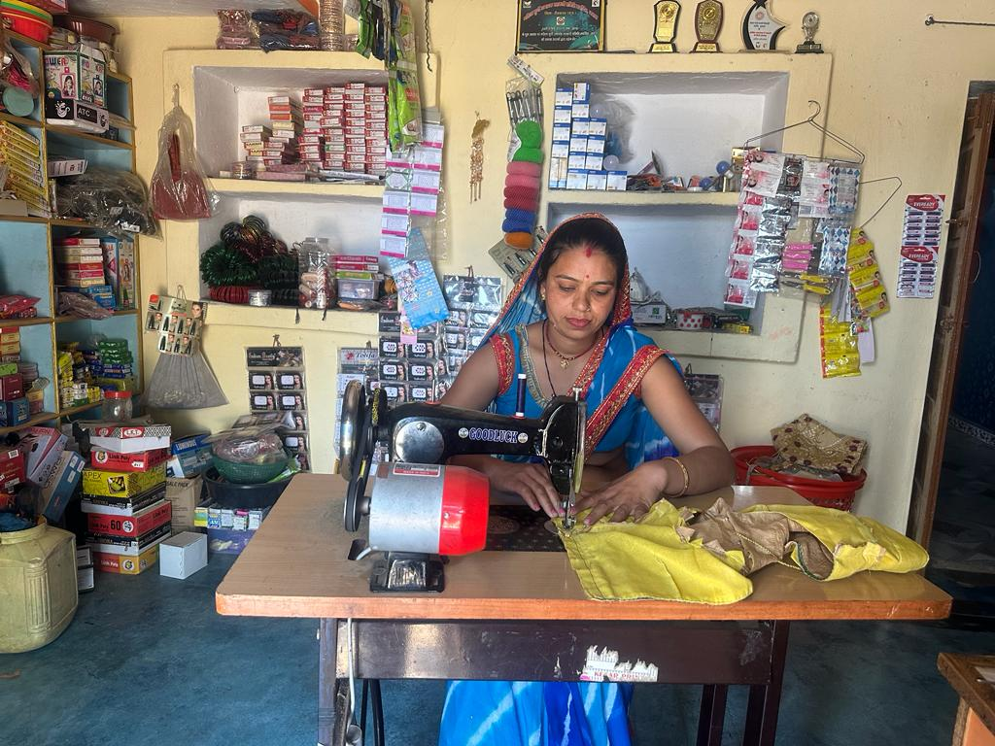
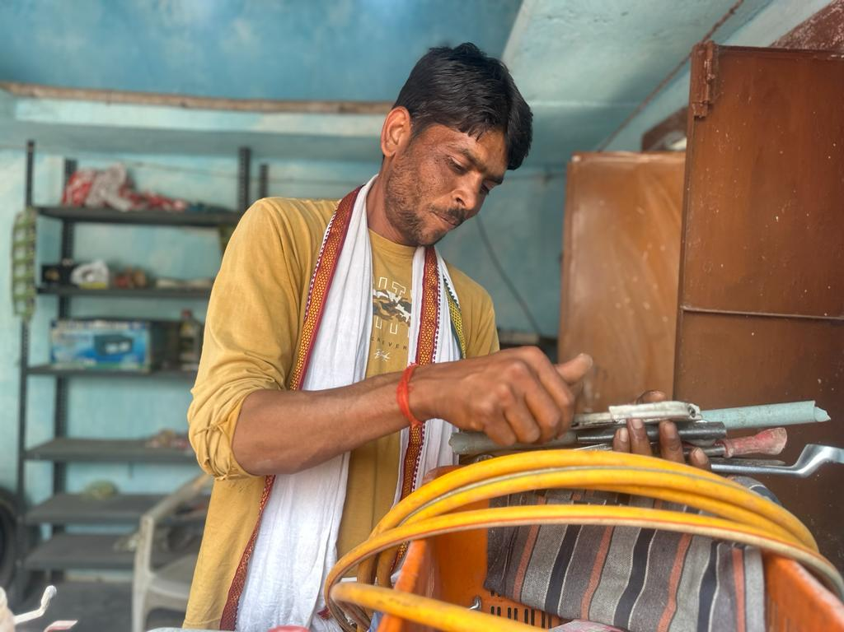
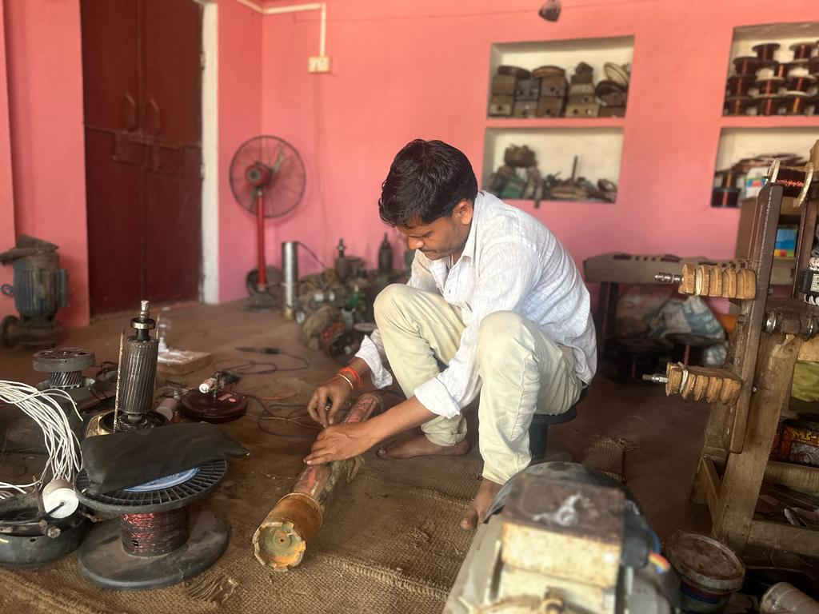
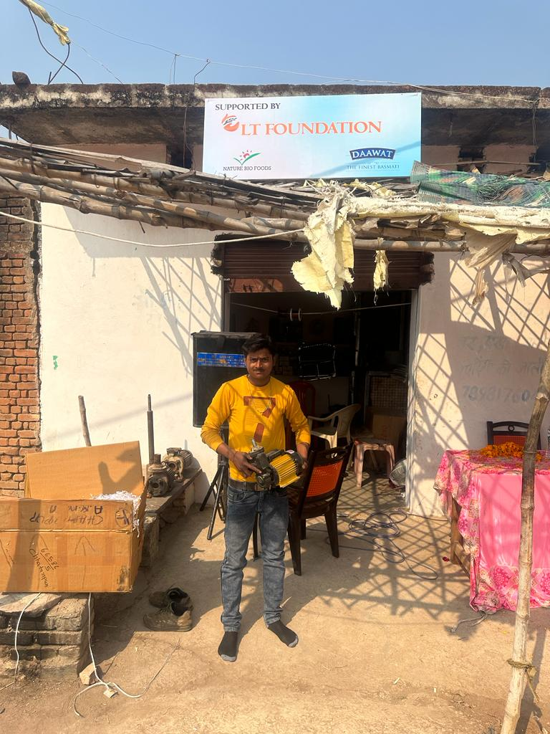

Slide 11
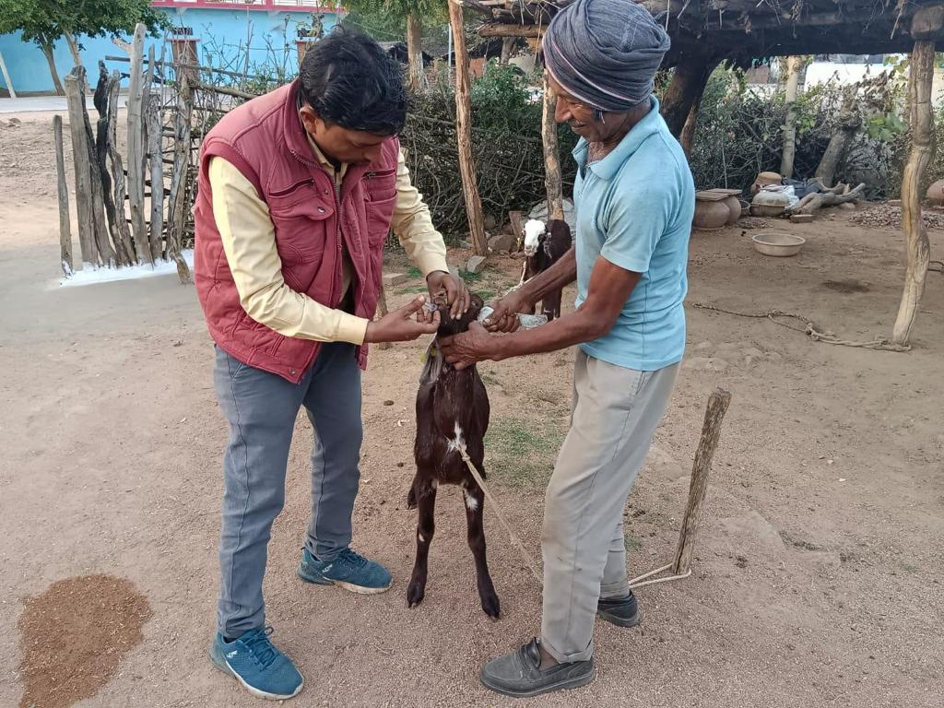
LIVELIHOOD Support – Goat Rearing Project
Sirohi breed of goats distributed to the poor and needy families of Chattarpur project location. By Goat rearing these families could earn their livelihood.
Year | Goats | Families
2021-22 | 45 | 30
2022-23 | 244 | 169
Total | 289 | 199

Slide 12
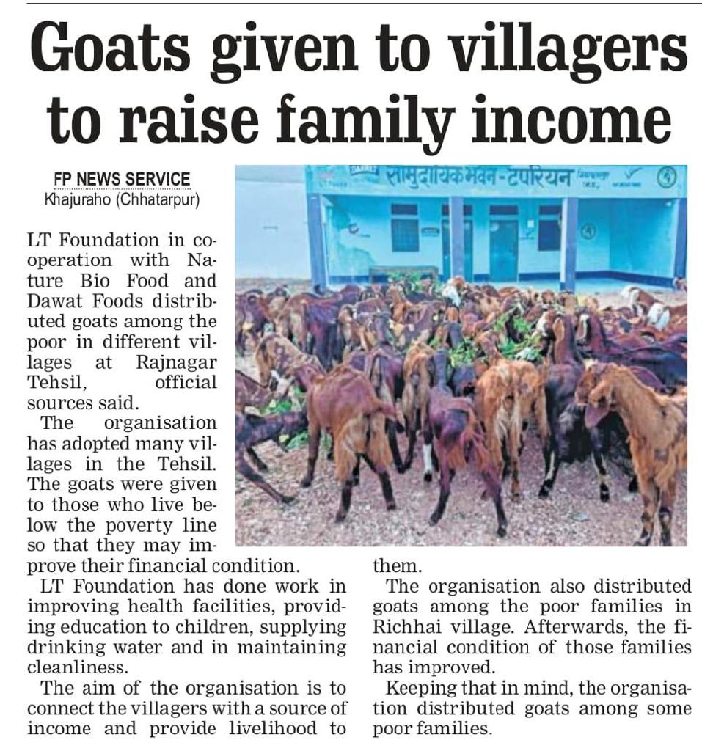
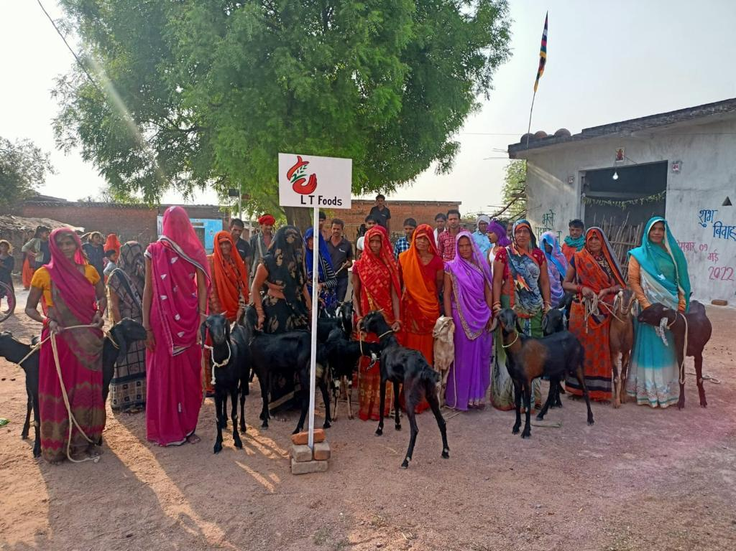
Beneficiaries : 199
Goats : 289
Milk for nutrition and consumption : + 40000 ltr Annual
Annual income to be raise on average of 12000/- to 15000/- yearly.

Slide 13
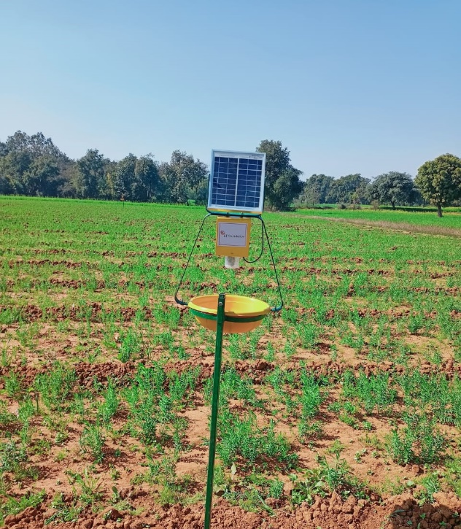
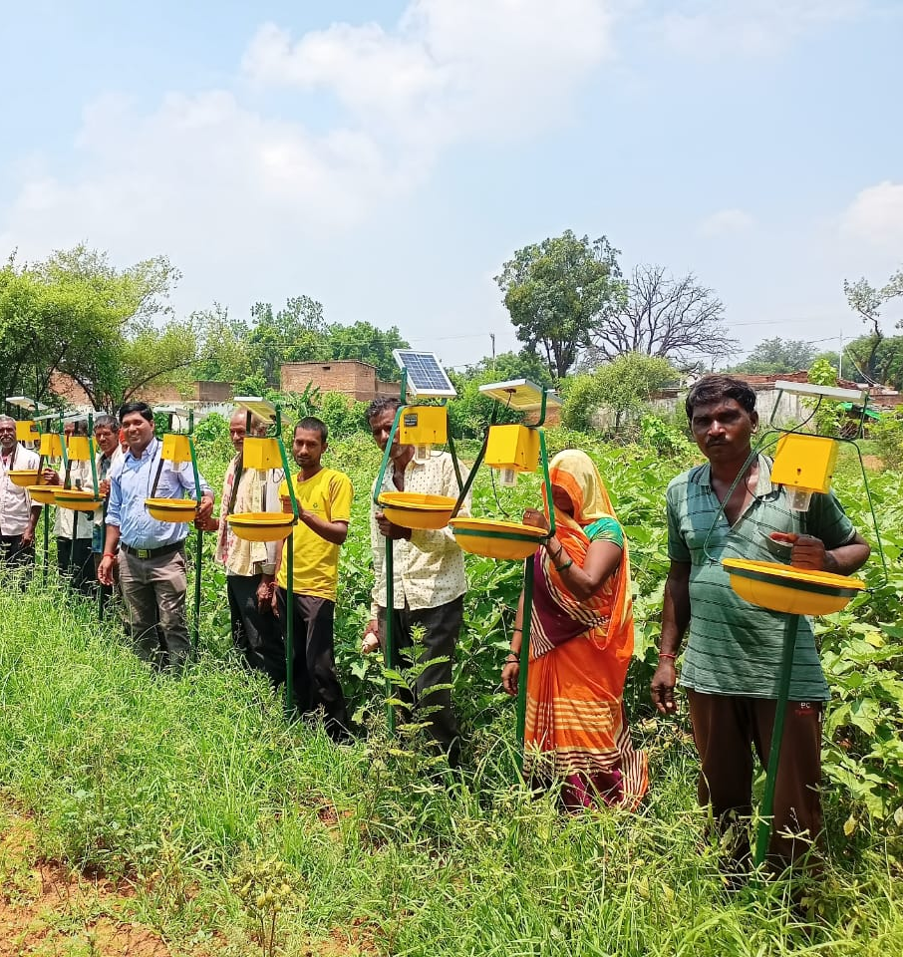
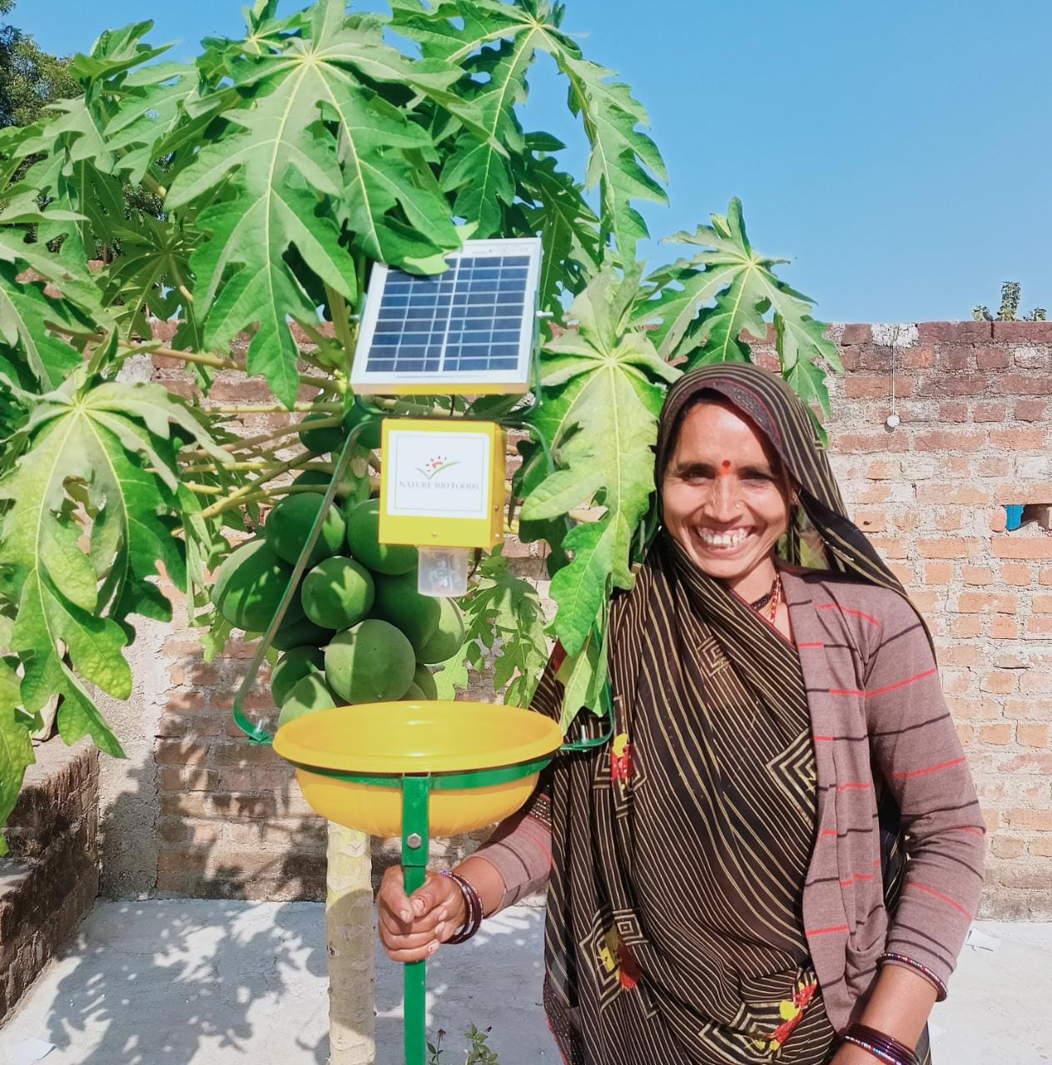
Solar Trap
LIVELIHOOD
Solar Trap is a kind of solar operated machines that save crops from insect attacks, that helps in maintaining crop quality and better crop yields.
Number of beneficiaries – 200
Feedback received from farmers that almost 40-50 % of insect attacks has been decreased due to the use of this trap.

Slide 14
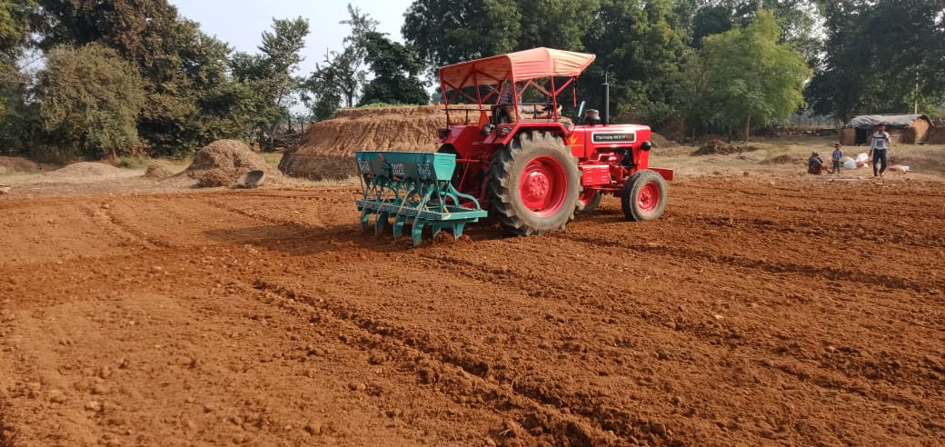
Agri Support – Usages of Agri-Implements ( Machineries)
Agriculture Service centre operated by Self Help Group now have provided different machineries on subsidised rates and used for their crop cultivation and harvesting.
Supported Equipment | Market Rates | LT Subsidized Rates | Saving Per Hour | No of Beneficiary
Multi crop Thresher | 1500 | 1100 | 400 | 252
Seed Drills, Cultivator & Summer Ploughing | 1000 | 600 | 400 | 767
Spray Pump | 2000 | Free Distribution | 2000 | 600

Slide 15
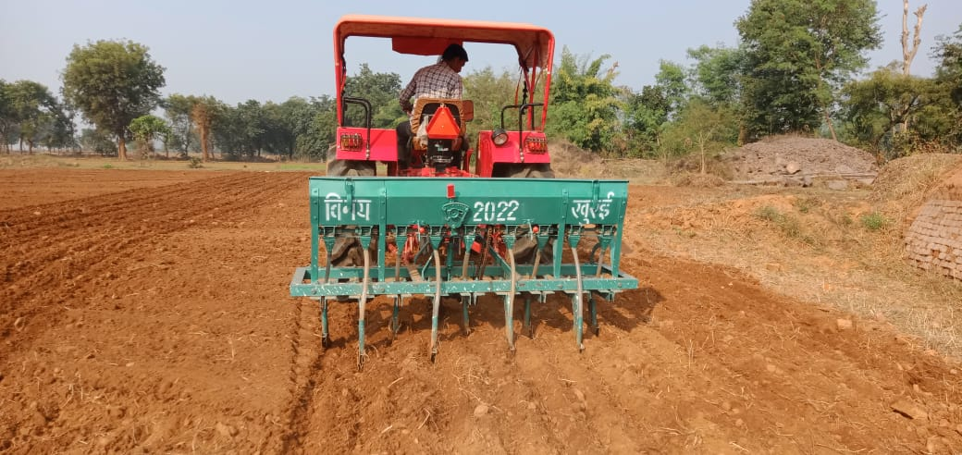
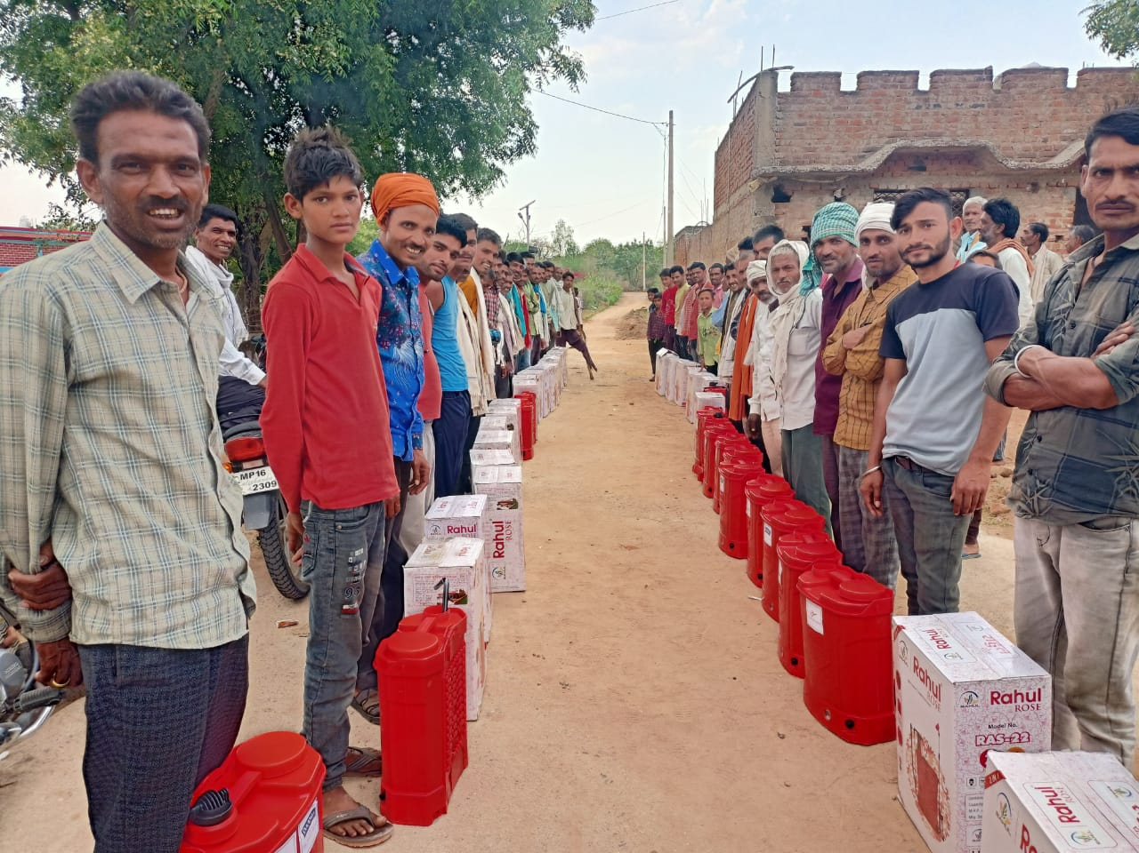
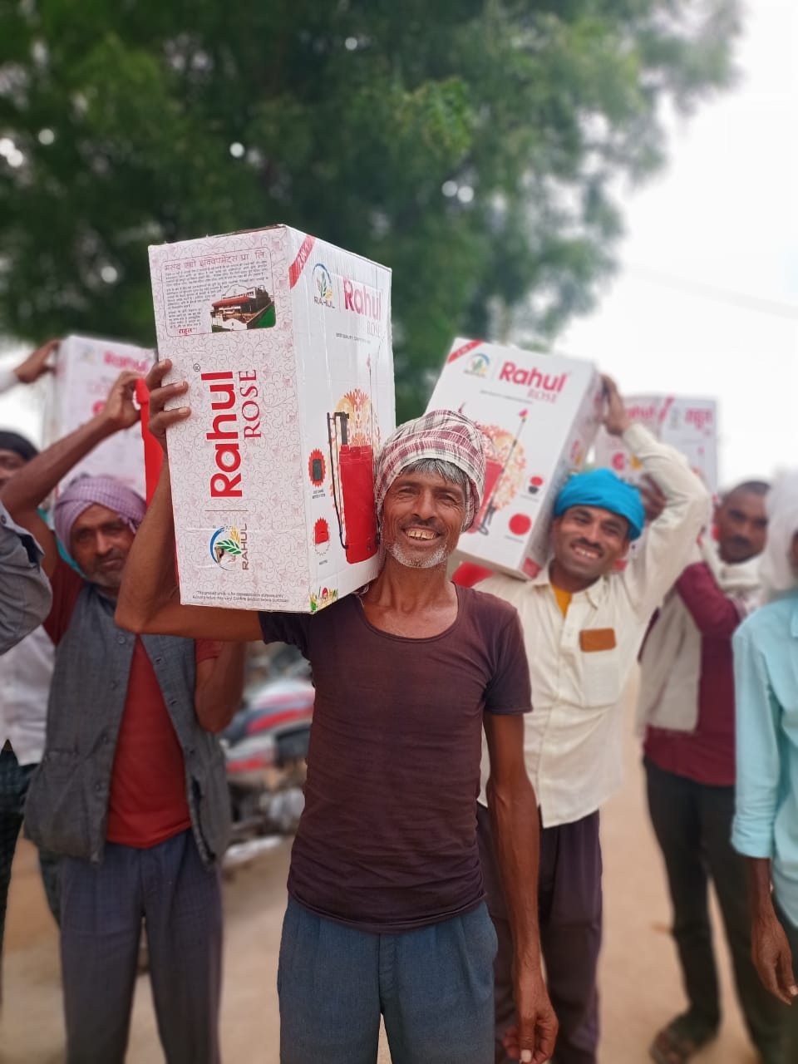
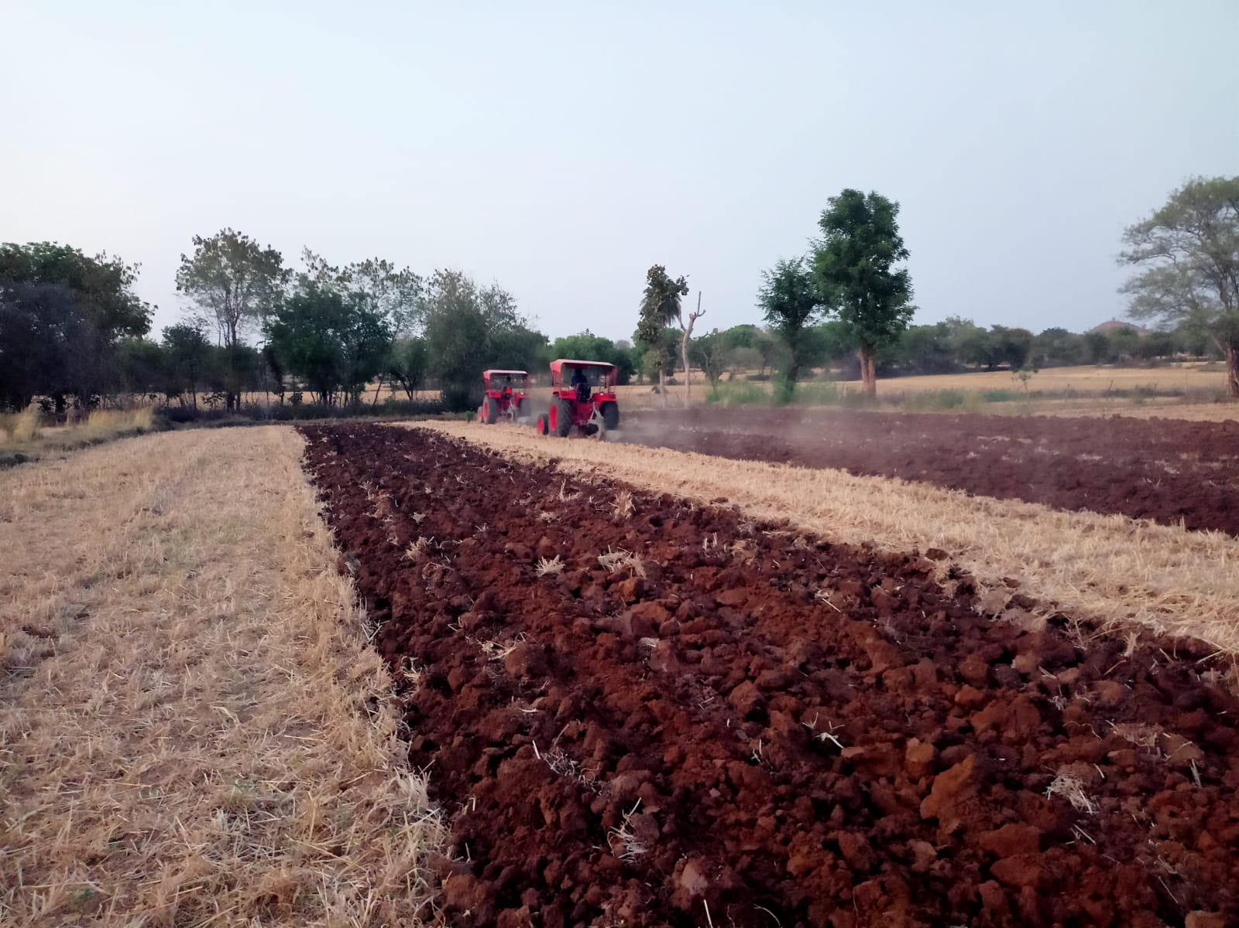
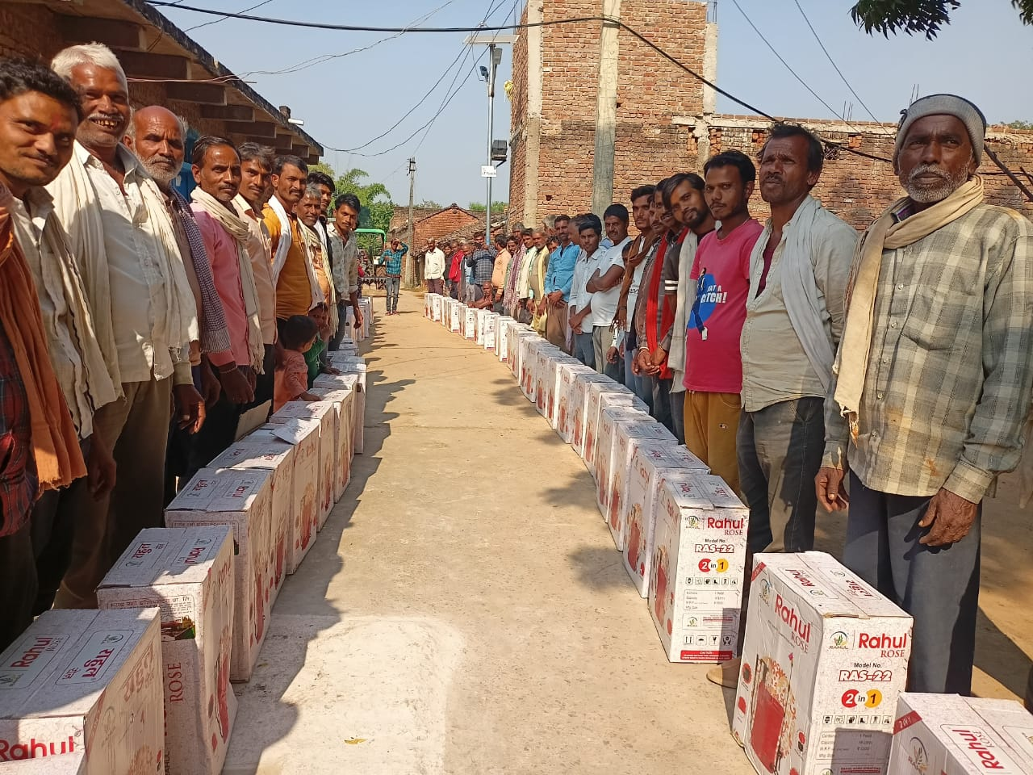

Slide 16
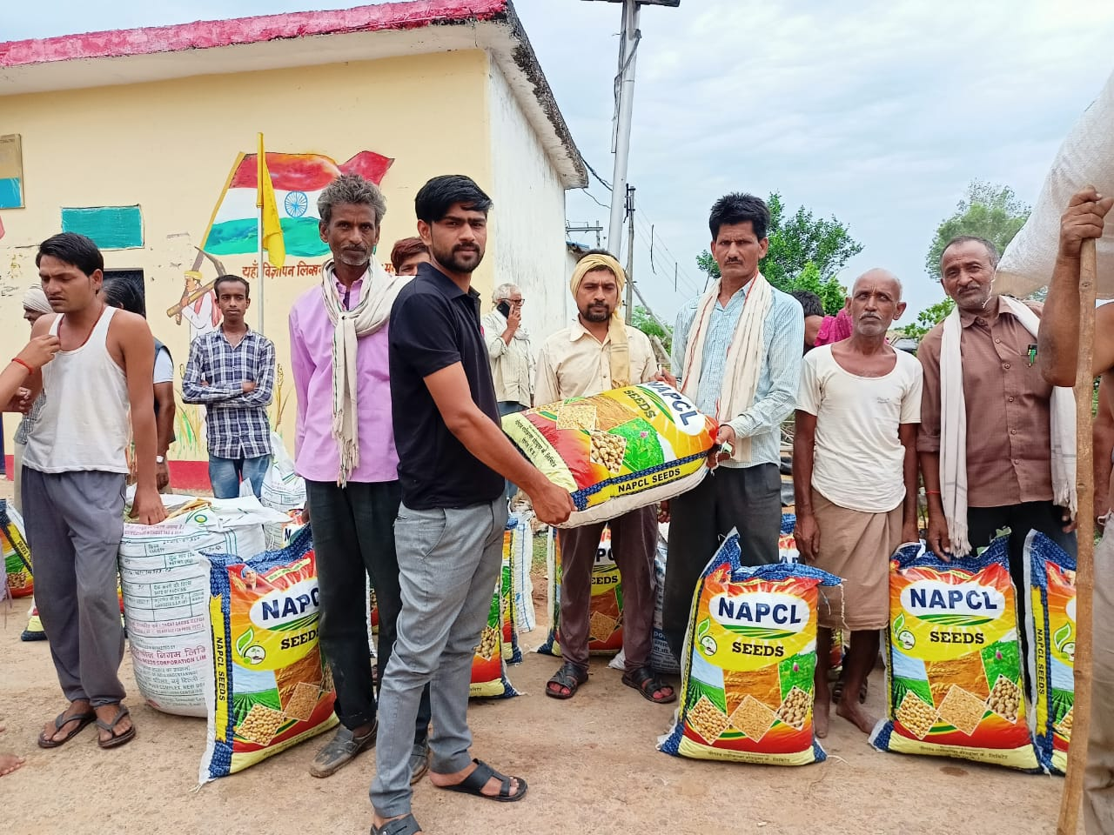
MOU WITH KVK TO SUPPORT THE PROJECT ON BEST AGRICULTURAL PRACTICES
In collaboration with Local government authorities good quality seed has been provided for best practices in the villages selected.
Total Quantity of Seed distributed – 6750 Kg.
Demonstration and dissemination of good agricultural practices
Seeds | In KG
Green Gram | 500
Black Gram | 1200
Sesame Seeds | 150
Ground Nut | 1500
Wheat | 500
Mustard Seed | 200
Pea | 900
Cheakpea | 1800

Slide 17
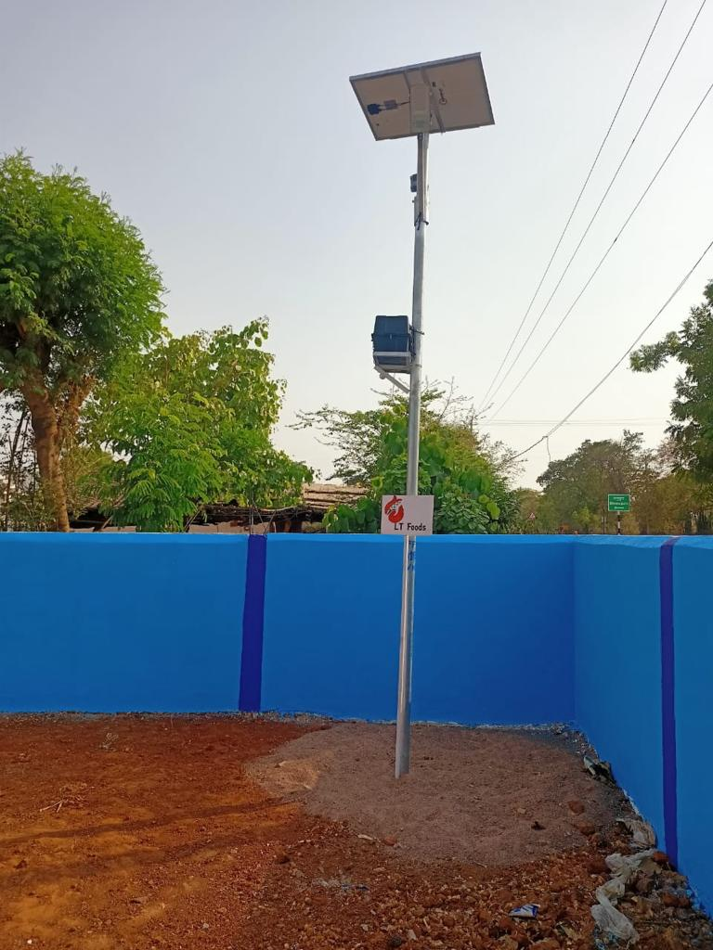
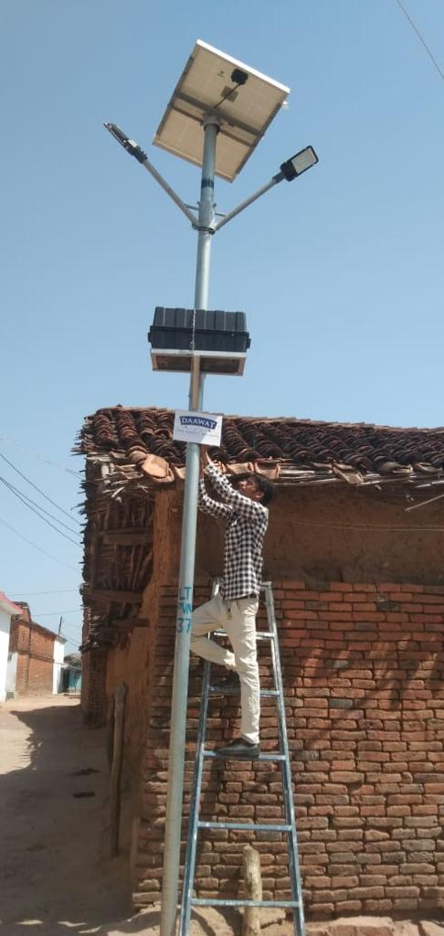
Now the Project is having total 323 Number of Solar Street lights installed.
159 Number of Solar Street Lights installed in FY 2022-23
100% Operational

Slide 18
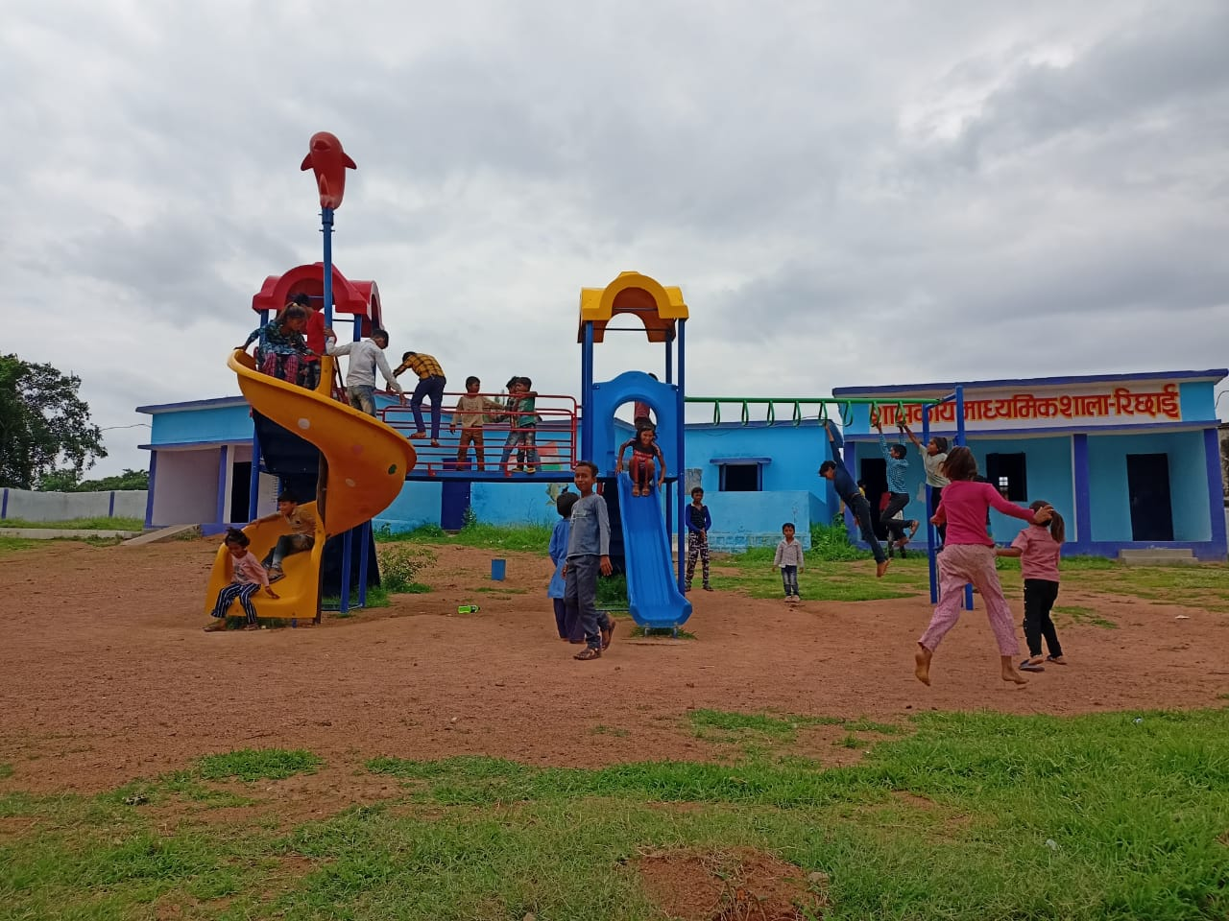
Education Project – School Adoption Program
Year | Number of Schools | Number of Students Supported | Digital Classrooms
2021-22 | 11 | 1129 | 4
2022-23 | 4 | 1245 | 6
Total | 15 | 2374 | 10

Slide 19
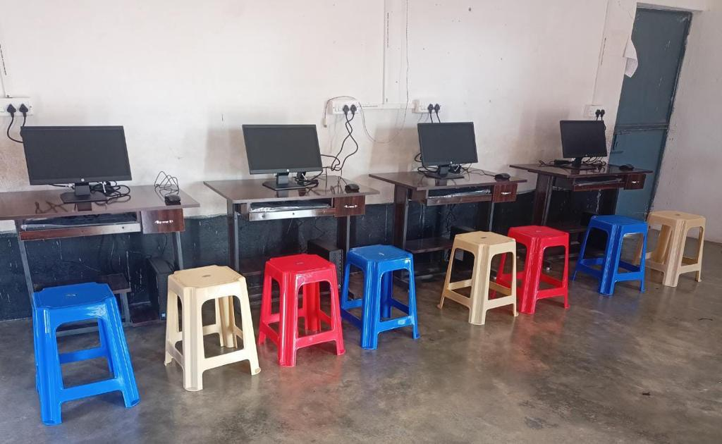

Slide 21
CURRENT STATUS

Slide 23
6 Villages Covered Under Roads and Drainage under the project
3 Community Centres
During the First Phase : Roads and Drainage constructed in One village

Slide 26
Bundelkhand Ratan Samman

Slide 28
STRONG COMMUNITY CONNECT

